Slide 1
Bien Dit! 2
Chapitre 3
Faisons les courses

Slide 2
un potage

Slide 3
un oignon

Slide 4
le poivron

Slide 5
la pomme de terre

Slide 6

la carotte

Slide 7
la courgette

Slide 8
le brocoli

Slide 9
Identifiez.

Slide 10
la tomate

Slide 11
le champignon

Slide 12
les petits pois

Slide 13
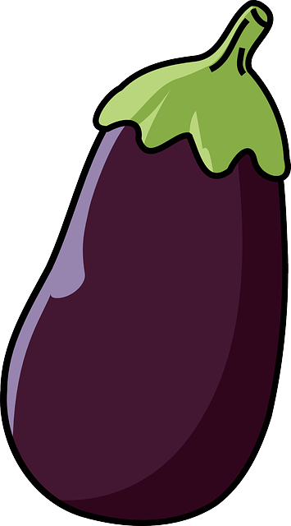
une aubergine

Slide 14
les haricots verts

Slide 15
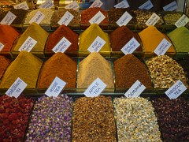
une épice

Slide 16
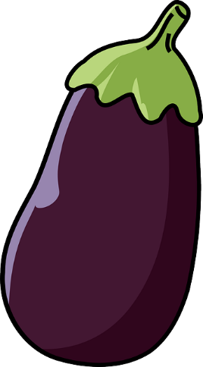
Identifiez.

Slide 17
les haricots verts
Identifiez.

Slide 18
la pomme de terre
Identifiez.

Slide 19
une aubergine
Identifiez.

Slide 20
le potage
Identifiez.

Slide 21
le champignon
Identifiez.

Slide 22
les petits pois
Identifiez.

Slide 23
le poivron
Identifiez.

Slide 24

la pêche

Slide 25

la framboise

Slide 26
un abricot

Slide 27
la banane

Slide 28
la poire

Slide 29
Identifiez.

Slide 30

la cerise

Slide 31
la fraise

Slide 32

la pomme

Slide 33
la pastèque

Slide 34
le melon

Slide 35
Identifiez.

Slide 36
la cerise
Identifiez.

Slide 37
la poire
Identifiez.

Slide 38
la framboise
Identifiez.

Slide 39
la pêche
Identifiez.

Slide 40
la fraise
Identifiez.

Slide 41
la pastèque
Identifiez.

Slide 42

une tasse de …

Slide 43

l’huile d’olive (f)

Slide 44
l’ail (m)

Slide 45

une cuillerée à café

Slide 46

une cuillerée à soupe

Slide 47
Identifiez.

Slide 48
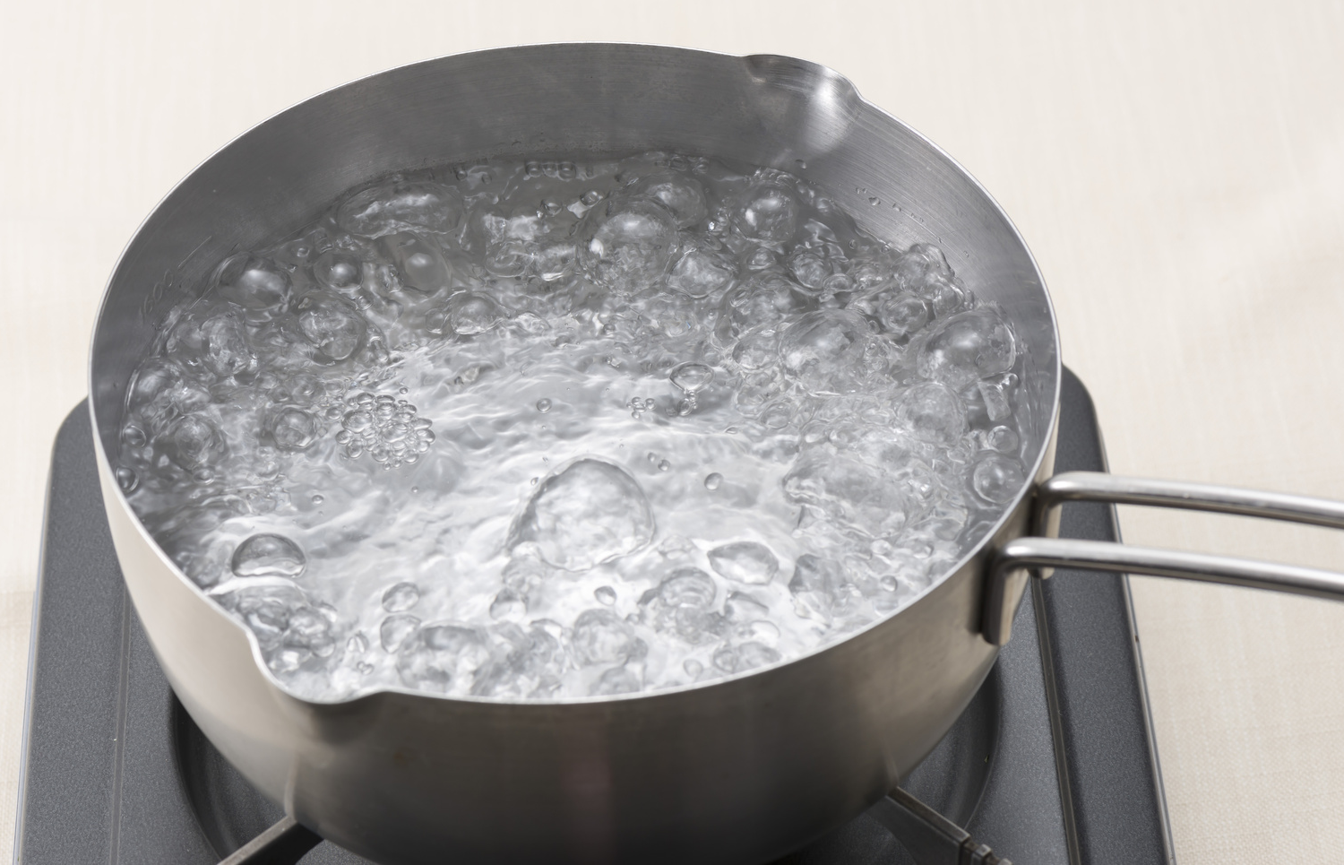
bouillir

Slide 49
faire cuire
to cook; to bake

Slide 50
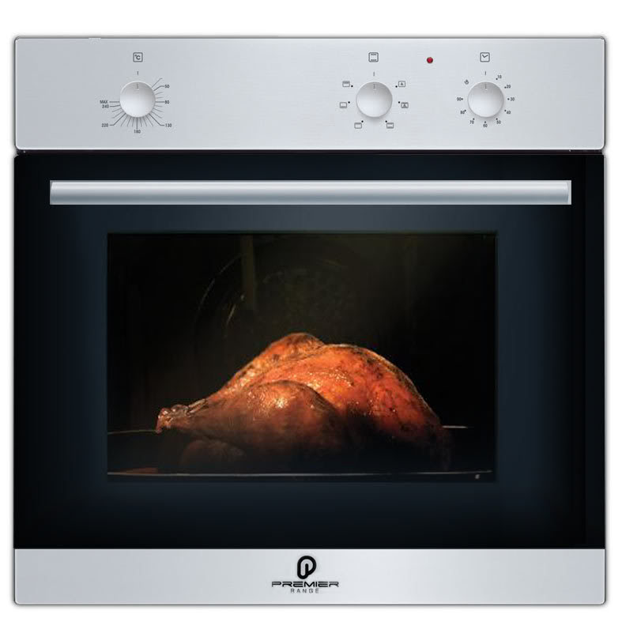
le four

Slide 51
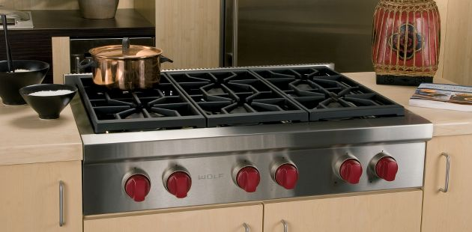
la cuisinière

Slide 52
la farine

Slide 53
le sucre

Slide 54
la laitue

Slide 55
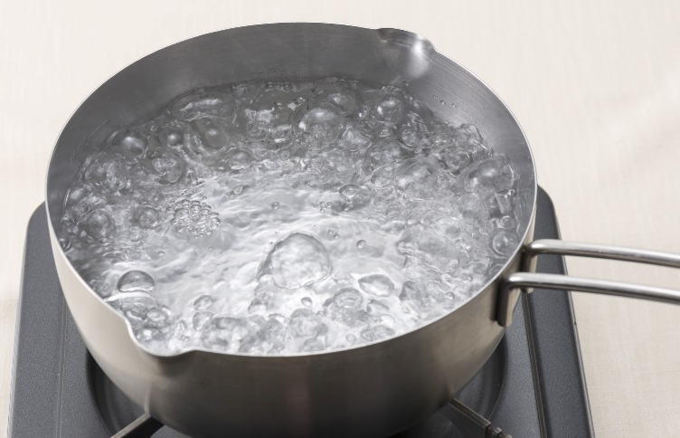
to cook; to bake
Identifiez.

Slide 56
Comment est-ce qu’on fait
How do you make

Slide 57
C’est facile de faire
Is it easy to make

Slide 58
Qu’est-ce qu’il y a dans
what’s in …

Slide 59
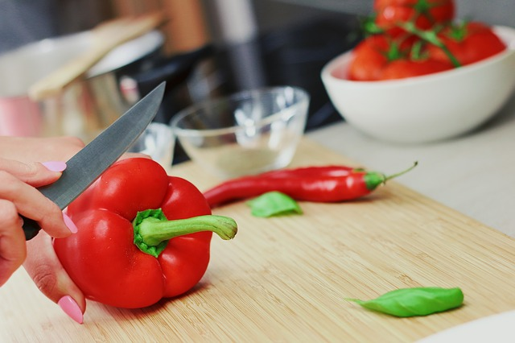
couper

Slide 60

ajouter

Slide 61
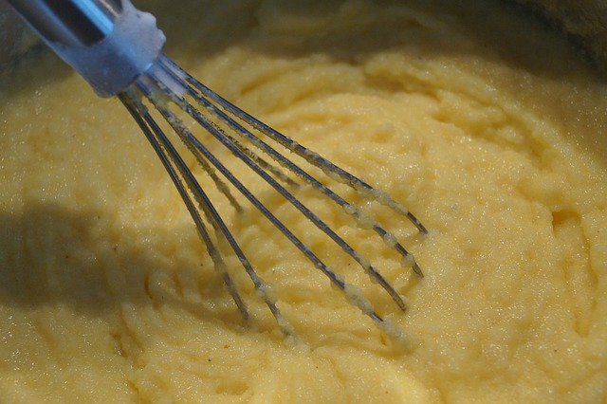
mélanger

Slide 62
c’est très simple
it’s very simple

Slide 63
c’est compliqué
it’s complicated

Slide 64
il y a
there is; there are

Slide 65

Identifiez.
is it easy to make
what’s in …
it’s very simple
how do you make
there is; there are
it’s complicated

Slide 66
is it easy to make
it’s very simple
Notes:
Use as a whole class or partner speaking activity. Practice using the vocab just presented.

Slide 67

there is/are
what’s in …
Notes:
Use as a whole class or partner speaking activity. Practice using the vocab just presented.

Slide 68
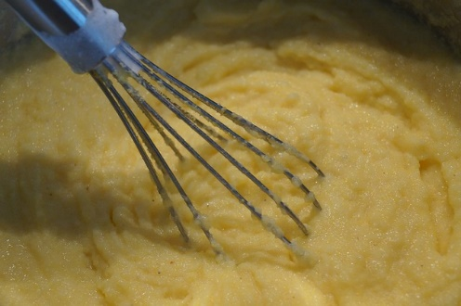


how do you make
Notes:
Use as a whole class or partner speaking activity. Practice using the vocab just presented.

Slide 69
is it easy to make
it’s complicated
Notes:
Use as a whole class or partner speaking activity. Practice using the vocab just presented.

Slide 70
how do you make
Notes:
Use as a whole class or partner speaking activity. Practice using the vocab just presented.

Slide 71
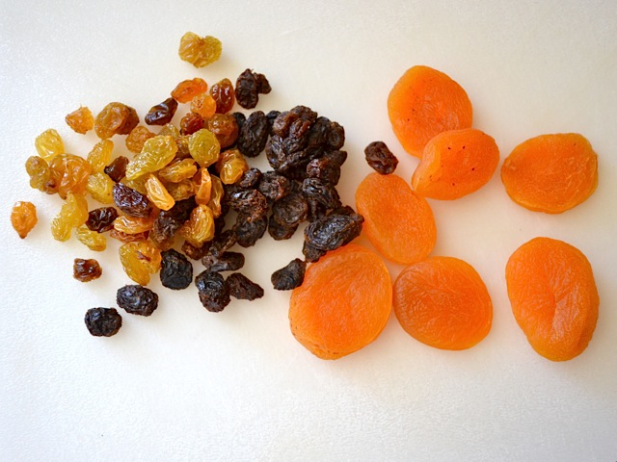
what’s in …
there is/are
Notes:
Use as a whole class or partner speaking activity. Practice using the vocab just presented.

Slide 72


Notes:
Have partners work together.

Slide 73
tu veux bien
can you
would you mind

Slide 74
tu me rapportes
can you bring me

Slide 75
j’y vais tout de suite
I’ll go there right away

Slide 76
je regrette
I am sorry

Slide 77
je suis trop occupé(e)
I’m too busy

Slide 78
rapporte(-moi)
bring (me)

Slide 79
n’oublie pas
don’t forget

Slide 80
Tu as besoin de rien d’autre?
Do you need anything else?

Slide 81
Il te faut autre chose?
Do you need anything else?

Slide 82
Do you need anything else? (2)
don’t forget
bring (me)
I’ll go there right away
can you bring me
Identifiez.
can you; would you mind
I’m too busy
I am sorry

Slide 83
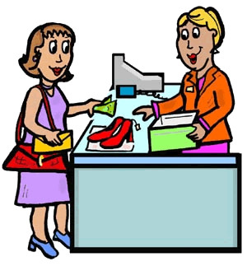
would you mind
I’ll go there right away

Slide 84
bring me
right away
Do you need anything else?

Slide 85
don’t forget
Do you need anything else?

Slide 86

would you mind
I am sorry
I’m too busy

Slide 87
can you bring me
I am sorry
I’m too busy

Slide 88
don’t forget
right away
Do you need anything else?

Slide 89
bring me
I am sorry
I’m too busy

Slide 90
can you bring me
I’ll go there right away

Slide 91
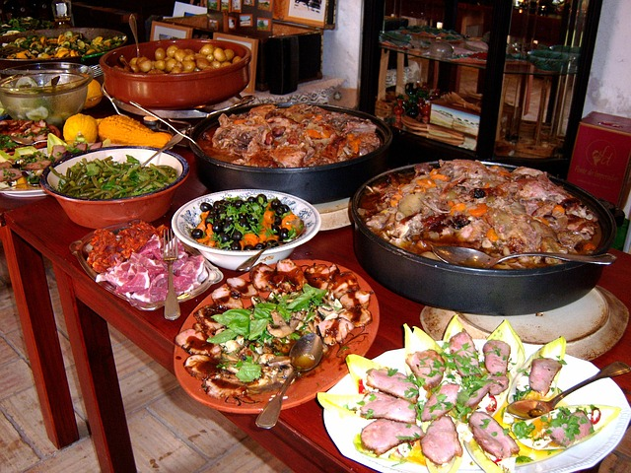
la bouffe
Entre
copains

Slide 92
bouffer
Entre
copains

Slide 93

la flotte
Entre
copains

Slide 94

les nouilles
Entre
copains

Slide 95
les patates
Entre
copains

Slide 96
Identifiez.
Entre
copains

Slide 97
qui
who

Slide 98
pourquoi
why

Slide 99
que (qu’)
what

Slide 100
combien de (d’)
how much
how many

Slide 101
quand
when

Slide 102
comment
how

Slide 103
où
where

Slide 104
what
why
how much/many
Identifiez.
how
when
where
who

Slide 105
what
nous
Notes:
Have partners work together and form questions using the given information.

Slide 106
why
ils
Notes:
Have partners work together and form questions using the given information.

Slide 107
how
tu
Notes:
Have partners work together and form questions using the given information.

Slide 108
how much/many
elle
Notes:
Have partners work together and form questions using the given information.

Slide 109
where
vous
Notes:
Have partners work together and form questions using the given information.

Slide 110
when
je
Notes:
Have partners work together and form questions using the given information.

Slide 111
who
Notes:
Have partners work together and form questions using the given information.

Slide 112
faire les courses

Slide 113
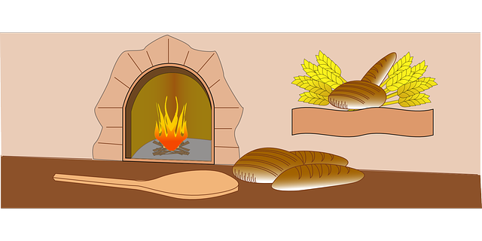
la boulangerie

Slide 114
le boulanger; la boulangère

Slide 115
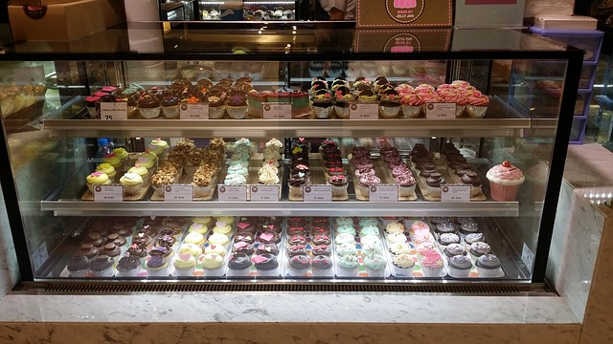
la pâtisserie

Slide 116
Identifiez.

Slide 117
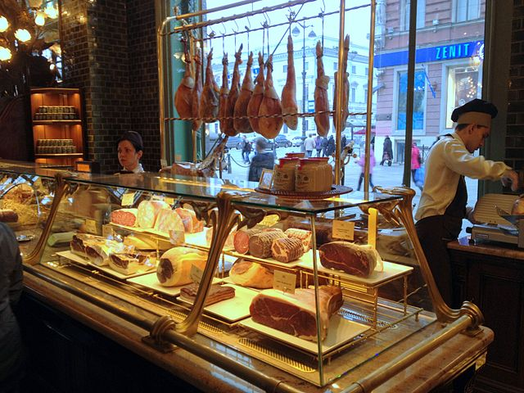
la boucherie

Slide 118
le boucher; la bouchère

Slide 119
le boeuf

Slide 120
une tranche de
a slice of

Slide 121
le jambon

Slide 122
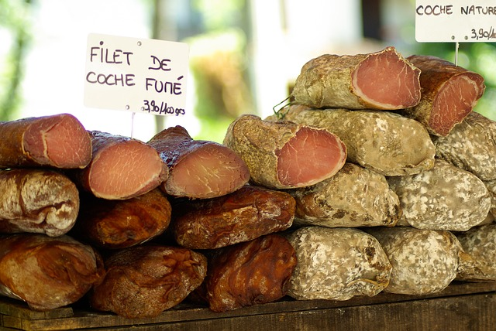
la charcuterie

Slide 123
a slice of
Identifiez.

Slide 124
le jambon
Identifiez.

Slide 125
le boulanger; la boulangère
Identifiez.

Slide 126
la pâtisserie
Identifiez.

Slide 127
faire les courses
Identifiez.

Slide 128
le boucher; la bouchère
Identifiez.

Slide 129
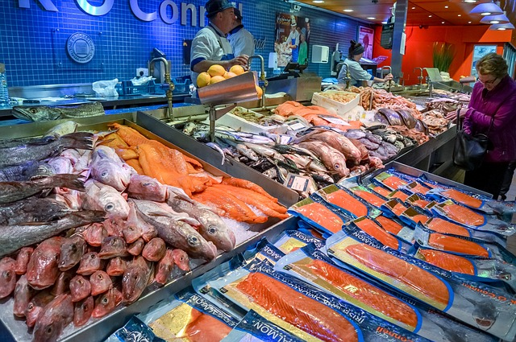
la poissonnerie

Slide 130
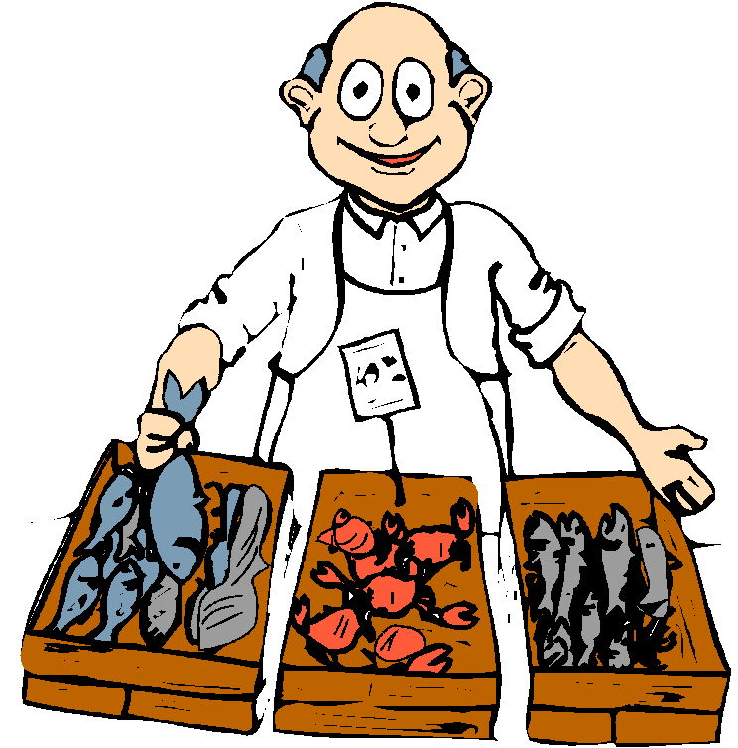
le poissonnier; la poissonnière

Slide 131
la crevette

Slide 132
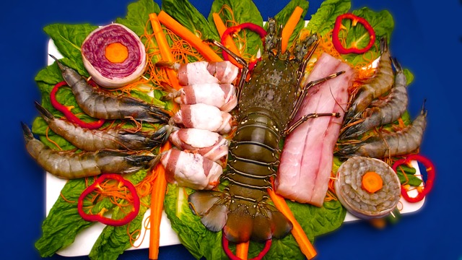
les fruits de mer

Slide 133
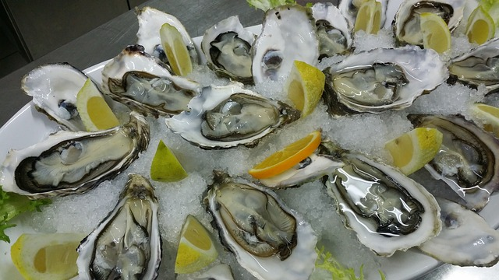
une huître

Slide 134
Identifiez.

Slide 135
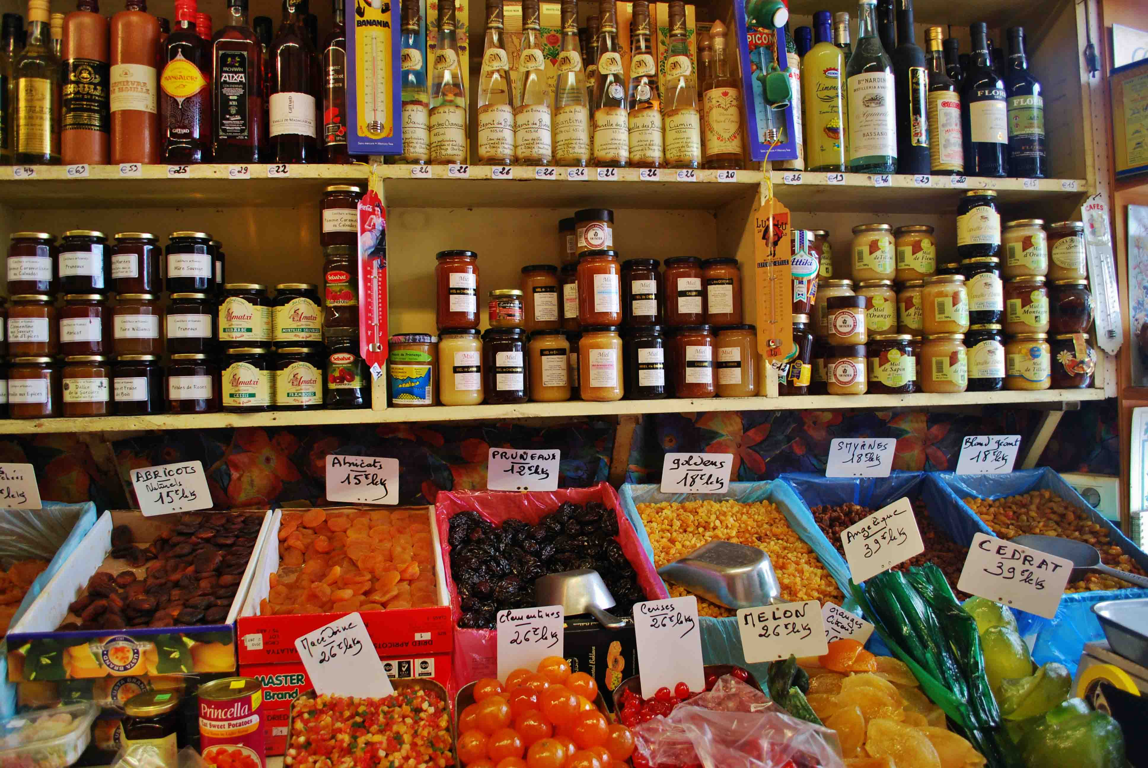
une épicerie

Slide 136
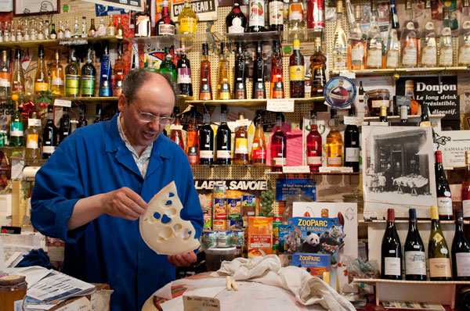
l’épicier; l’épicière

Slide 137

une boîte (de conserve)

Slide 138


Identifiez.

Slide 139
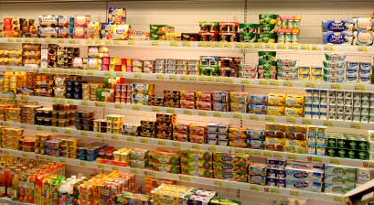
la crémerie

Slide 140
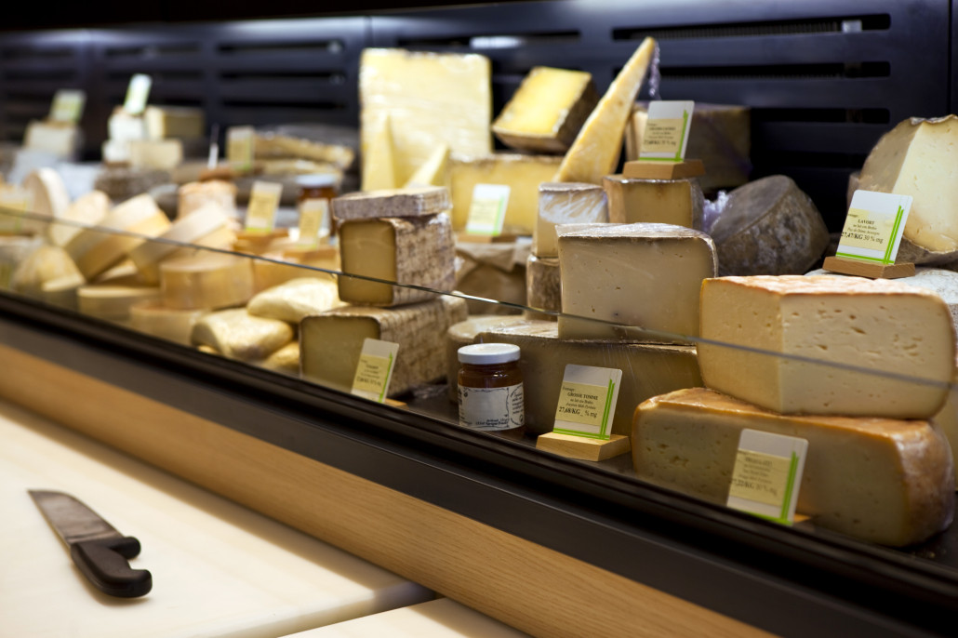
la fromagerie

Slide 141
le yaourt

Slide 142
un morceau de
a piece of

Slide 143
le fromage

Slide 144

a piece of
Identifiez.

Slide 145
where
on
à la charcuterie
Notes:
This can be used as a whole class or partner speaking activity. First, ask where one buys the pictured food. Second, answer with the correct store.

Slide 146
where
on
à la fromagerie
Notes:
This can be used as a whole class or partner speaking activity. First, ask where one buys the pictured food. Second, answer with the correct store.

Slide 147
where
on
à la poissonnerie
Notes:
This can be used as a whole class or partner speaking activity. First, ask where one buys the pictured food. Second, answer with the correct store.

Slide 148
where
on
à la boucherie
Notes:
This can be used as a whole class or partner speaking activity. First, ask where one buys the pictured food. Second, answer with the correct store.

Slide 149
where
on
à la crémerie
Notes:
This can be used as a whole class or partner speaking activity. First, ask where one buys the pictured food. Second, answer with the correct store.

Slide 150
where
on
à la poissonnerie
Notes:
This can be used as a whole class or partner speaking activity. First, ask where one buys the pictured food. Second, answer with the correct store.

Slide 151

where
on
à l’épicerie
Notes:
This can be used as a whole class or partner speaking activity. First, ask where one buys the pictured food. Second, answer with the correct store.

Slide 152
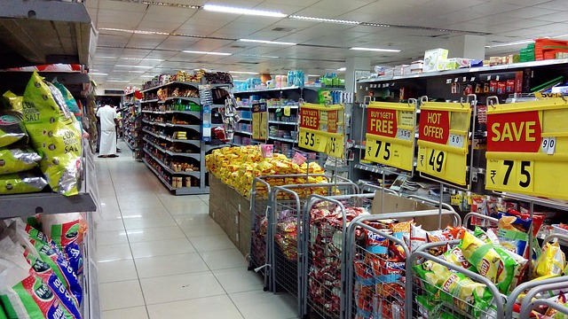
le supermarché

Slide 153
le caissier; la caissière

Slide 154
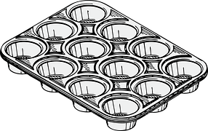
une douzaine de

Slide 155
un oeuf

Slide 156
un paquet de
a package of

Slide 157

les pâtes (f)

Slide 158

une bouteille de

Slide 159
a package of
Identifiez.

Slide 160
l’eau (f)

Slide 161

un pot de

Slide 162
la confiture

Slide 163
un litre de
a liter of

Slide 164

le jus d’orange

Slide 165
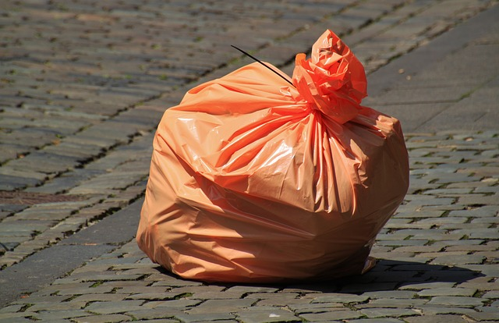
un sac en plastique

Slide 166
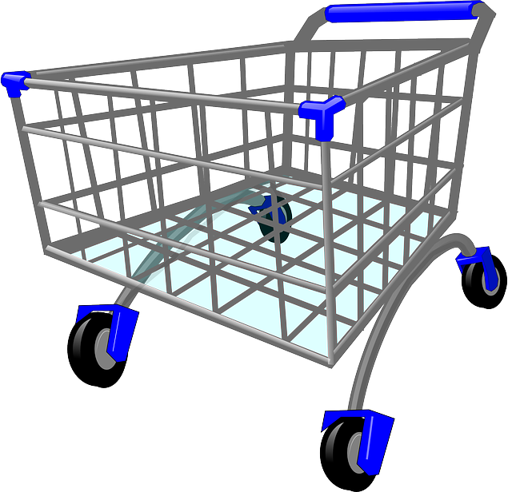
le chariot

Slide 167
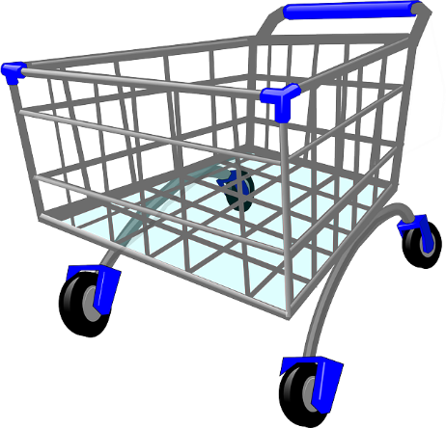
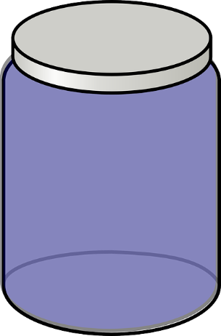
a liter of
Identifiez.

Slide 168
nous
a package of
Notes:
Have partners work together and tell the quantity of the item being bought.

Slide 169
tu
a liter of
Notes:
Have partners work together and tell the quantity of the item being bought.

Slide 170
vous
Notes:
Have partners work together and tell the quantity of the item being bought.

Slide 171
elle
a kilo of
Notes:
Have partners work together and tell the quantity of the item being bought.

Slide 172
je
Notes:
Have partners work together and tell the quantity of the item being bought.

Slide 173
ils
Notes:
Have partners work together and tell the quantity of the item being bought.

Slide 174
Qu’est-ce qu’il vous faut?
What do you need?

Slide 175
il me faut
I need

Slide 176
Combien vous en faut-il?
How many/much do you need?

Slide 177
à peu près
about

Slide 178
une livre
one pound

Slide 179
environ
approximately

Slide 180
Identifiez.
about
approximately
What do you need?
one pound
I need
How many do you need?

Slide 181
vous les voulez comment
how do you want

Slide 182
(bien) mûr(e)(s)
(very) ripe

Slide 183
c’est … le kilo
It’s … per kilo.

Slide 184
je vais en prendre
I’ll take

Slide 185
Ce sera tout?
Will that be all?

Slide 186
c’est tout pour aujourd’hui
that’s all for today

Slide 187
that’s all for today
ripe
it’s … per kilo
Identifiez.
how do you want
Will that be all?
I’ll take

Slide 188
What do you need?
How many do you need?
I’ll take
approximately
one pound
Notes:
Use as partner speaking activity.

Slide 189
What do you need?
I need
about
one pound
It’s 7€ per kilo.
That’s all for today.
Will that be all?
Notes:
Use as partner speaking activity.

Slide 190
How many do you need?
I need
about
one kilo
how do you want
ripe
Notes:
Use as partner speaking activity.

Slide 191
How many do you need?
I’ll take
approximately
How do you want
one pound
very ripe
It’s 8€ per kilo.
that’s all for today
Will that be all?
Notes:
Use as partner speaking activity.

Slide 192
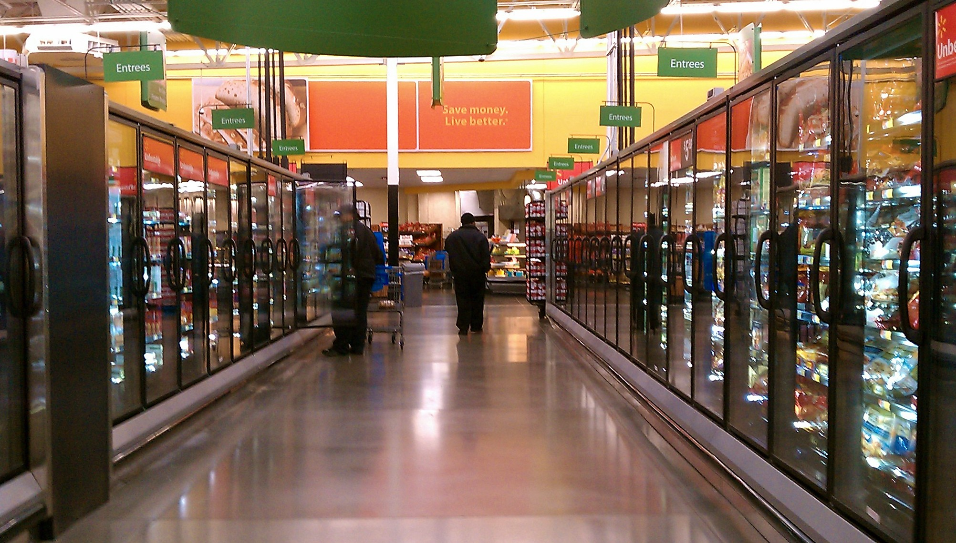
les produits congelés

Slide 193
alors
well

Slide 194
tout près
right next to

Slide 195
Où est-ce que je pourrais trouver
Where could I find

Slide 196
si vous allez
if you go

Slide 197
au bout de
at the end of

Slide 198
ça se trouve où
… is found where

Slide 199
au milieu de
in the middle of

Slide 200

Identifiez.
where could I find
in the middle of
if you go
… is found where
well
right next to
at the end of

Slide 201
devant
in front of

Slide 202
derrière
behind

Slide 203
entre
between

Slide 204
à côté de
next to

Slide 205
à droite de
to the right of

Slide 206
à gauche de
to the left of

Slide 207
to the right of
Identifiez.
behind
between
to the left of
next to
in front of

Slide 208
Where could I find
right next to
Notes:
Use as partner speaking activity.

Slide 209
at the end of
… is found where
Notes:
Use as partner speaking activity.

Slide 210
between
… is found where
Notes:
Use as partner speaking activity.

Slide 211
Where could I find
to the right of
Notes:
Use as partner speaking activity.

Slide 212
Where could I find
behind
Notes:
Use as partner speaking activity.

Slide 213
in front of
… is found where
Notes:
Use as partner speaking activity.

Slide 214
next to
… is found where
Notes:
Use as partner speaking activity.

Slide 215
Where could I find
in the middle of
Notes:
Use as partner speaking activity.

Slide 216
Where could I find
to the left of
Notes:
Use as partner speaking activity.

